Slide 1
Category review: Chips
January 2021
Retail Analytics
Brand note: If client logo is not required, use alternate title page layout right click slide thumbnail > Layout > Title

Slide 2
Notes:
To view Privacy video explaining how important data privacy is to Quantium, please click here: https://www.youtube.com/watch?v=Zq1QDAkoRzU
or here Q:\Company Reference\Brand & Design\Brand videos\Q Privacy.mp4
At Quantium, we believe that data is the behavioural footprint of humanity and that it has to be treated with the utmost care and responsibility.
Histories, attitudes, indeed lives are stored within it in ways that aren’t always apparent – and that’s what makes its potential so powerful.
To work with it responsibly, sensitively, we set ourselves the highest data privacy protection and governance standards.
We have spent 17 years perfecting privacy-by-design and secure-by-design principles. Central to this is not holding any personally identifiable information about people –
we neither receive it, and put the necessary protections in place to be unable to decipher it.
Every aspect of handling data is safeguarded: from its de-identification, to its encryption – data security is paramount and of the highest grade.
We pride ourselves on gaining the trust of iconic organisations around the world through years of securely working with their data,
and in turn the trust that builds with their stakeholders.

Slide 3
Executive summary
Sales have mainly been due to
Budget - older families
Mainstream - young singles/couples
Mainstream - retires
01
Task 1
02
The three trial stores all showed significant increase (p<0.05) in total sales and customer numbers during the trial period compared to the control stores
Task 2

Slide 4
01
Category

Slide 5
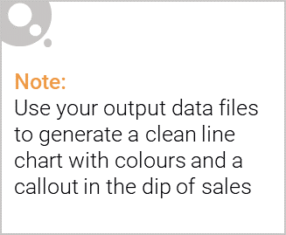
Overview
Sales have mainly been due to Budget - older families, Mainstream – young singles/couples and Mainstream – retires’ shoppers
The total sales of Mainstream – young singles/couples and Mainstream – retires are high because they have larger number of customers
The old family and young family are generally buying more chips per customer

Slide 6

Commentary on affluence and its effect on consumer buying for the category of chips
Take Mainstream mid-age and young single/couples as segment:
Unit Price: the price per unit chips are significant (p<0.05) higher than other groups
Brand: they are 23% more willing to purchase Tyrrells and 56% less willing to purchase Burger Rings
Pack Size: they are 27% more willing to purchase 270 g package size than others, which were only provided by the Twisties.
Premium people usually spend less in chips probably because they are willing to purchase more healthy food.

Slide 7
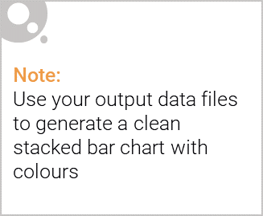
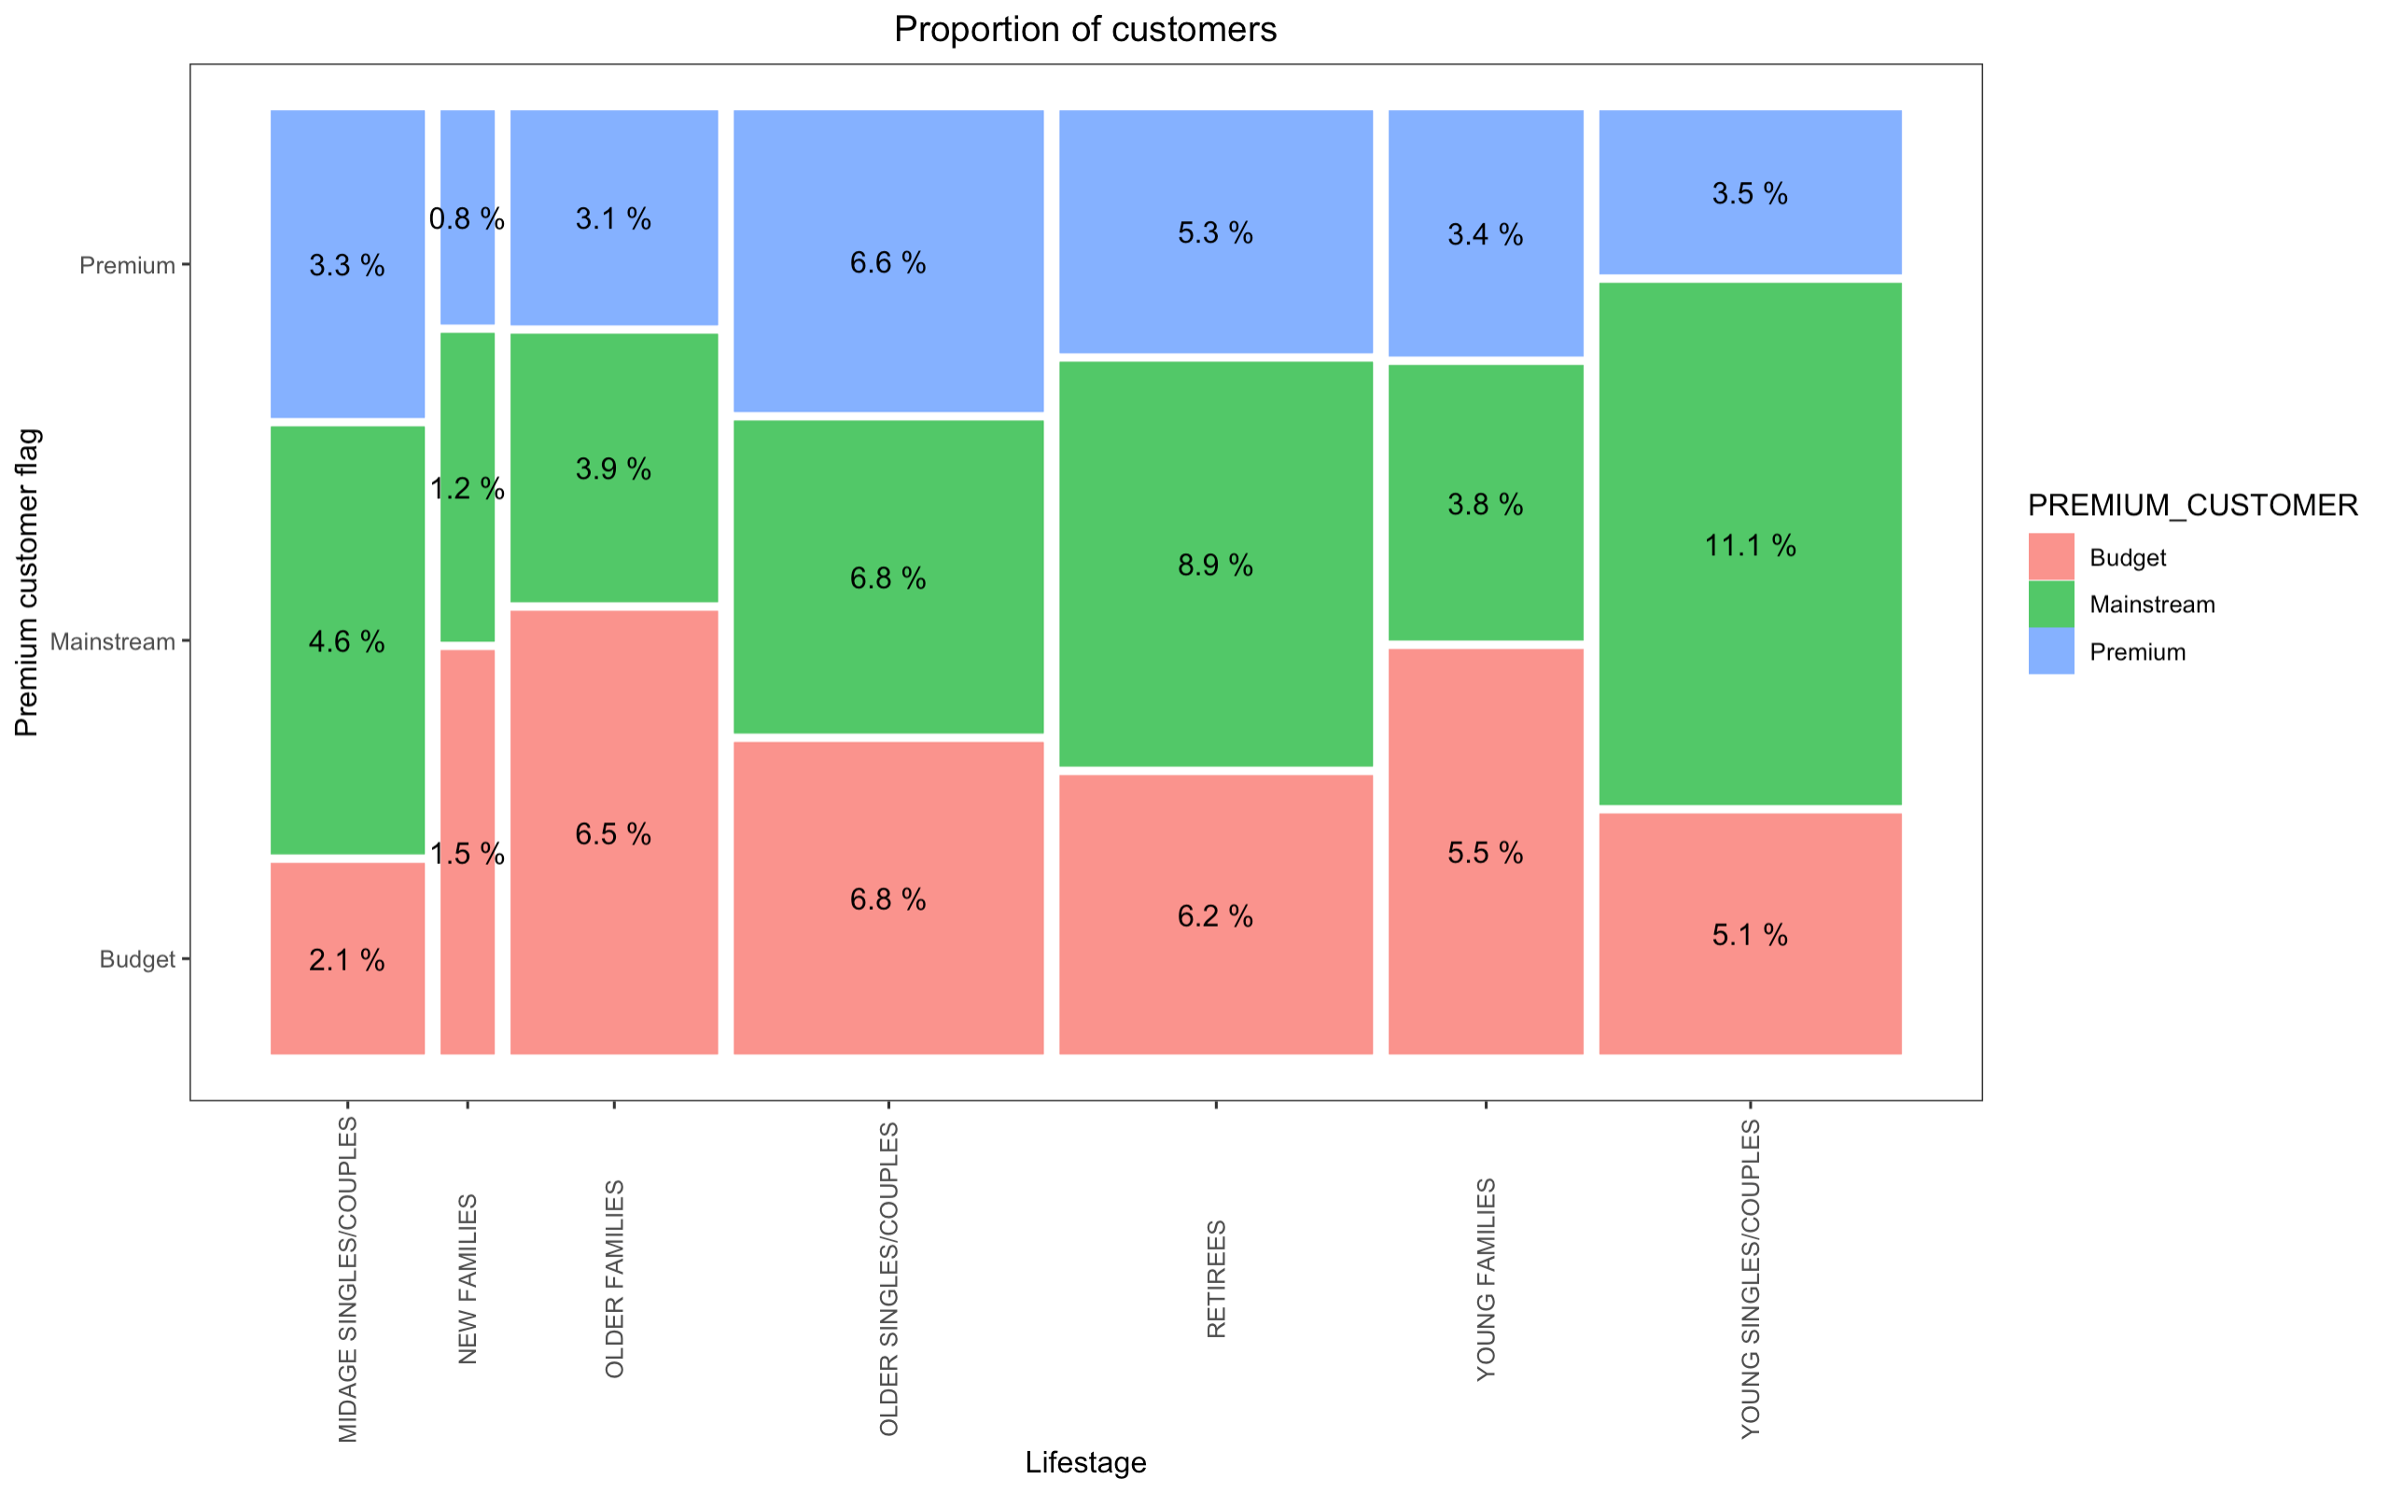
Editable (delete this)
Stretch: The proportion of customers by affluence and life stage

Slide 8
02
Trial store performance

Slide 9
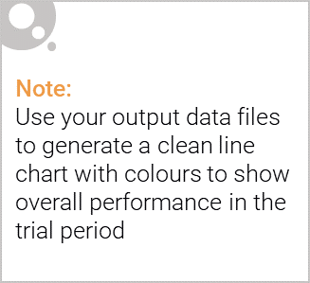
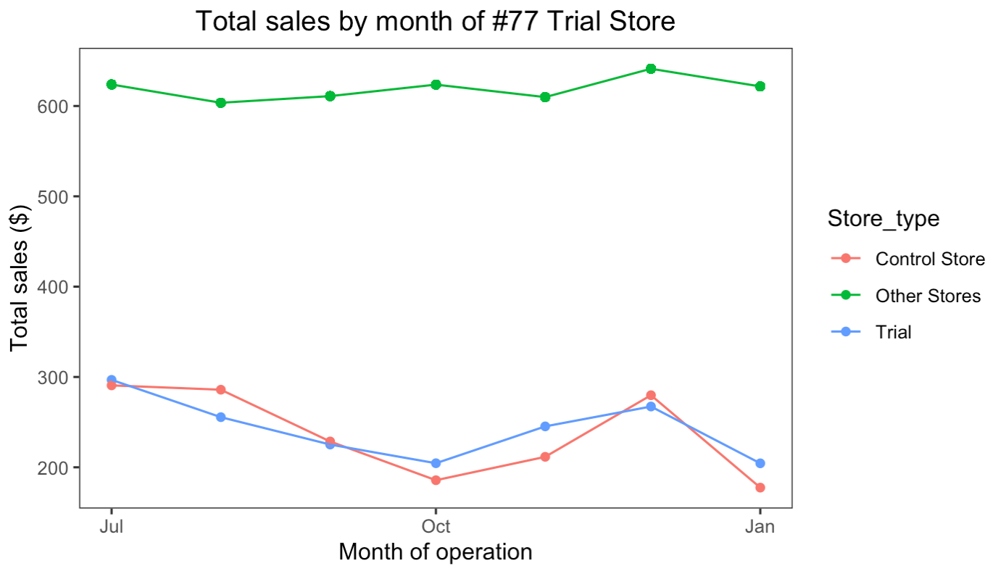
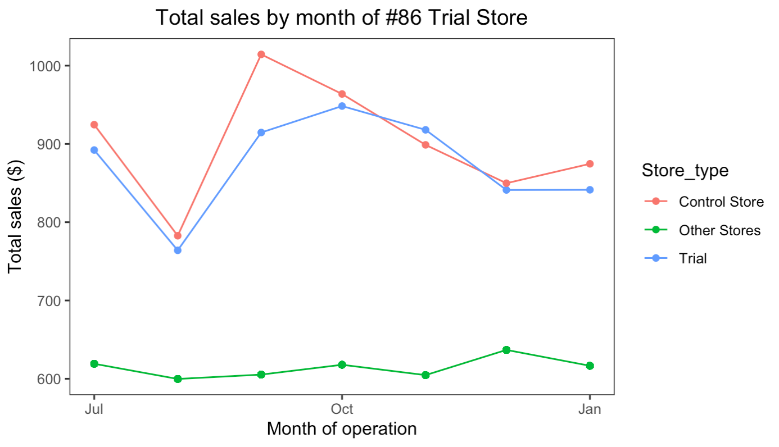
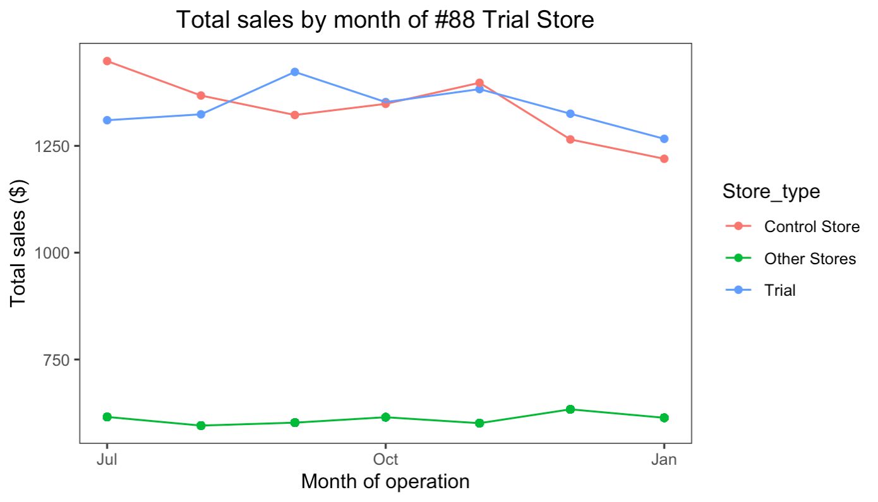
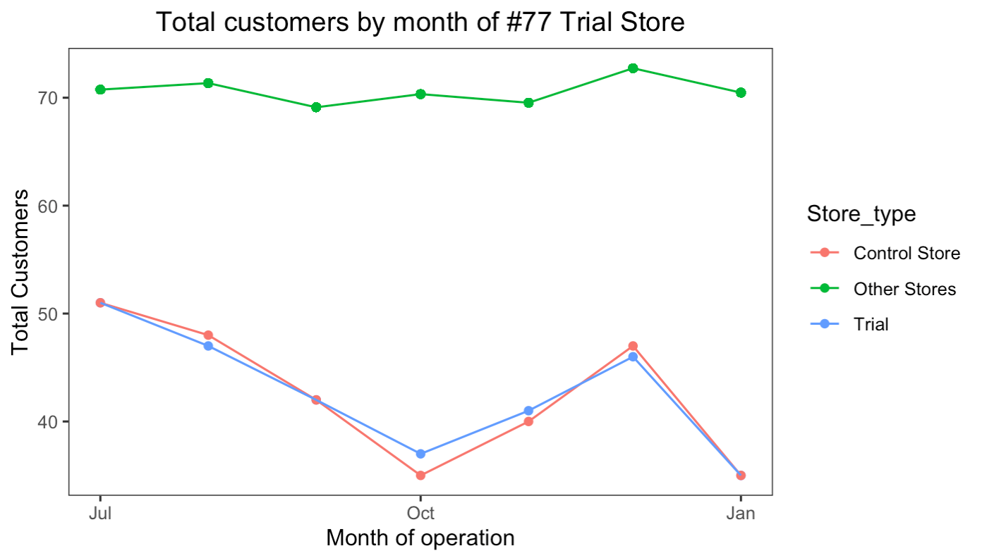
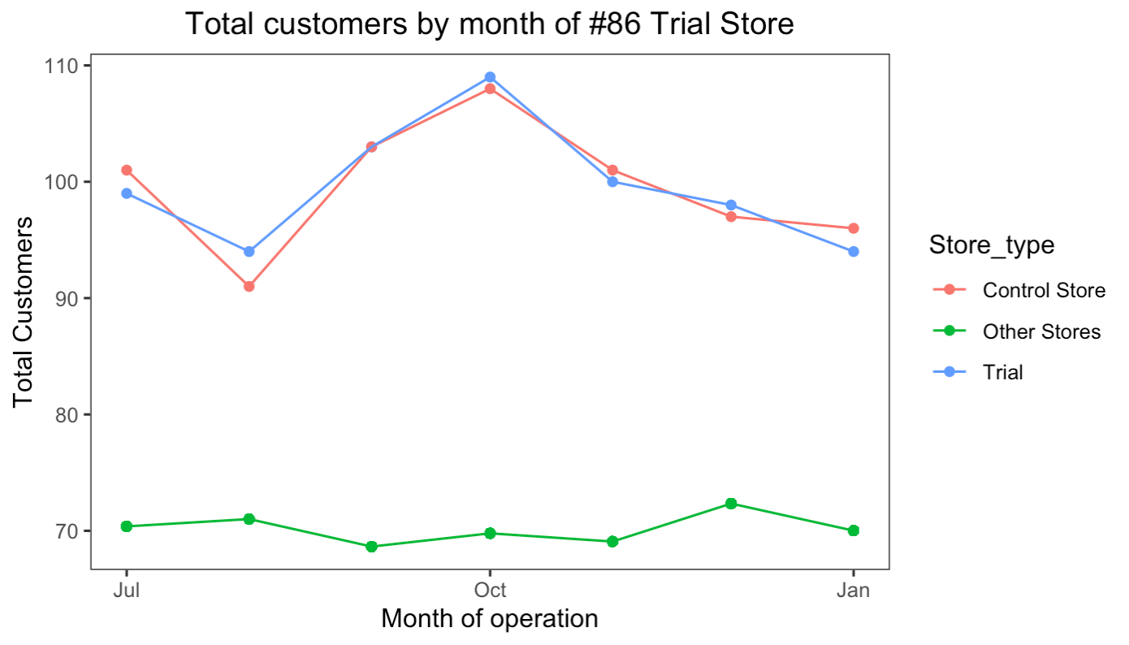
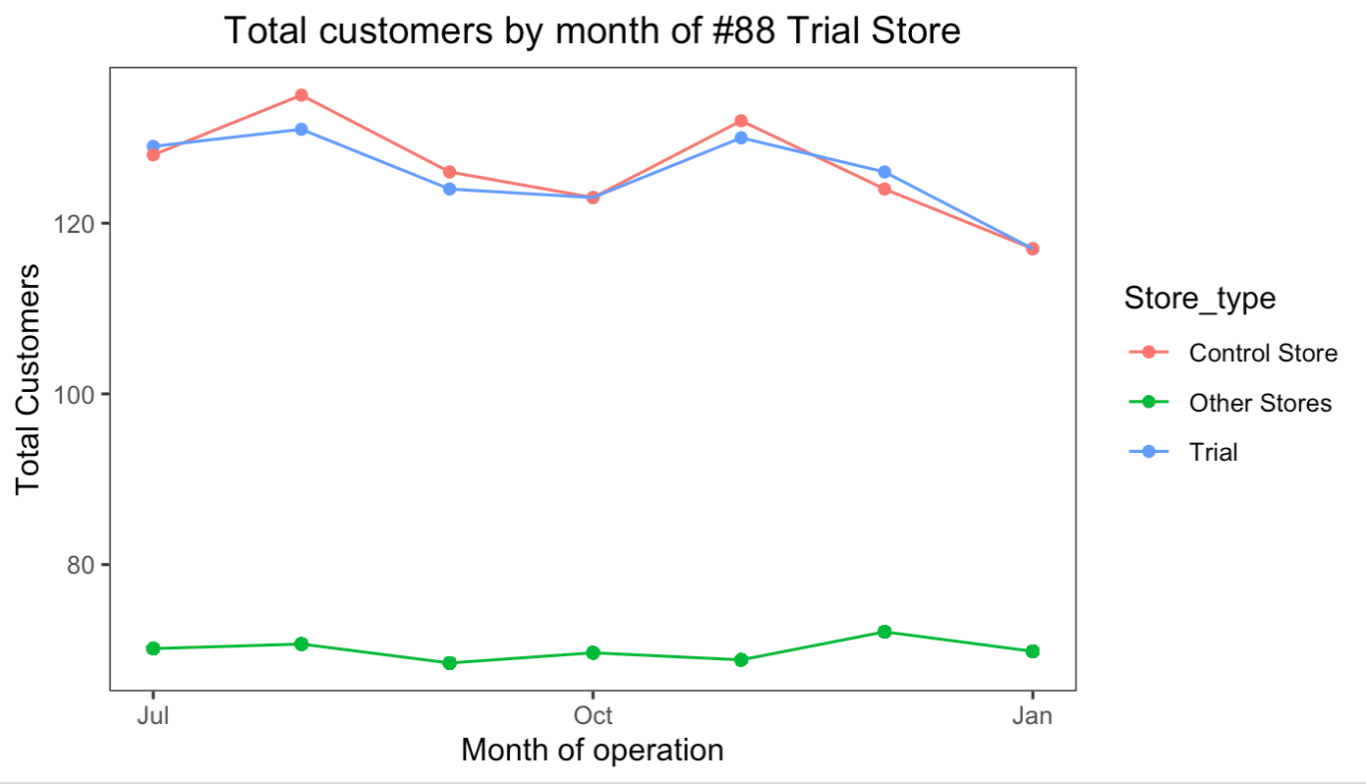
Explanation of the control store vs other stores
The control Store is the most similar one to the trial Store before the trial period in total sales per month and number of customer per month. Which were calculated by the same weight of correlation and standardized magnitude distance of total sales and customers per month.

Slide 10
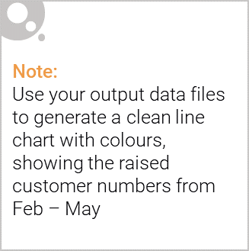
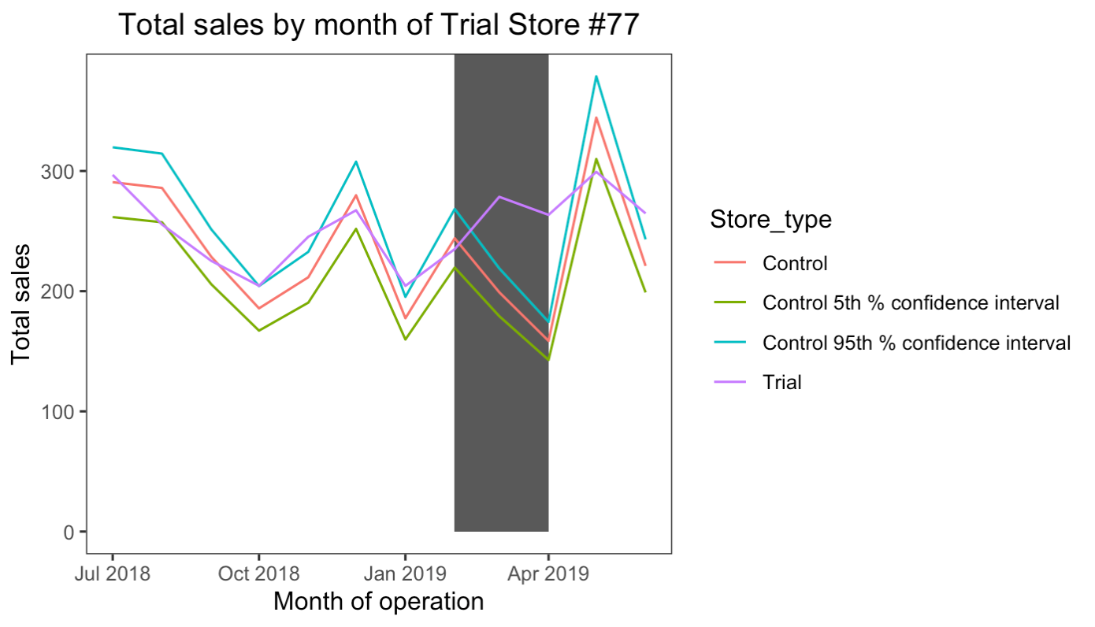
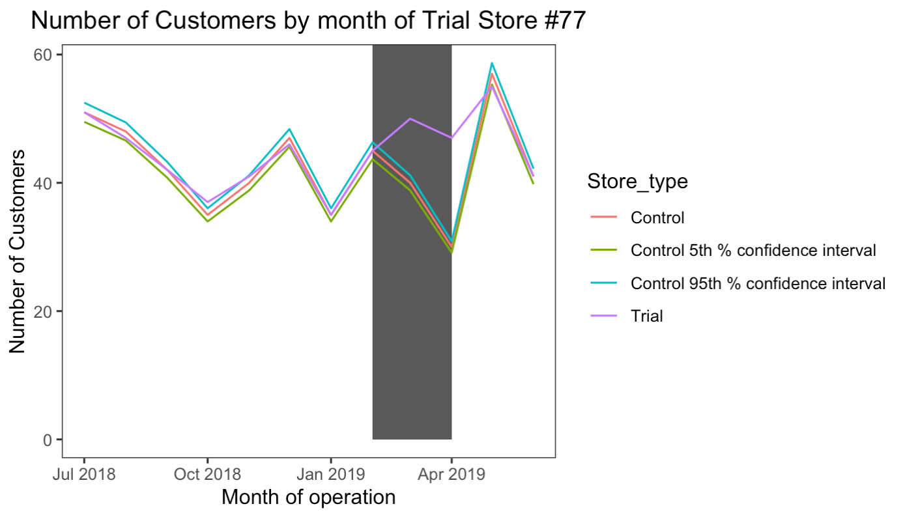
The performance in the trial store #77
The total sales and number of customers per month were all increase significantly (p<0.05),
especially for Marth and April
SUCCESSFUL!

Slide 11
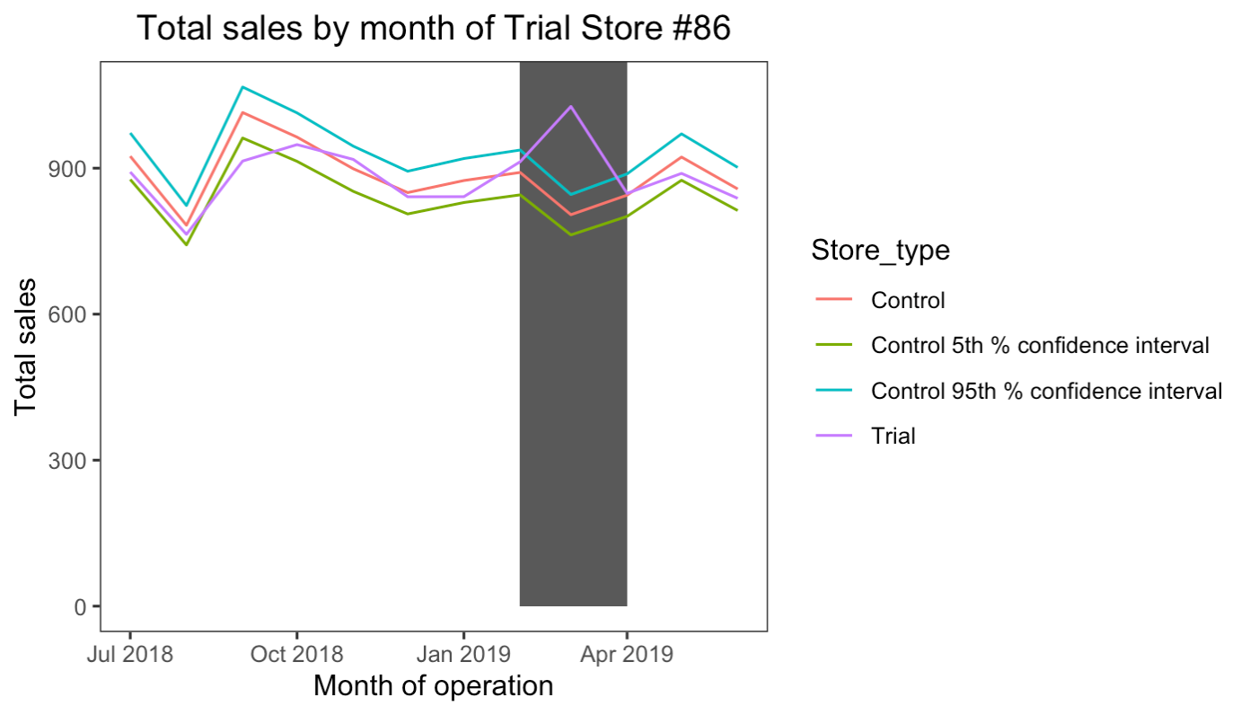
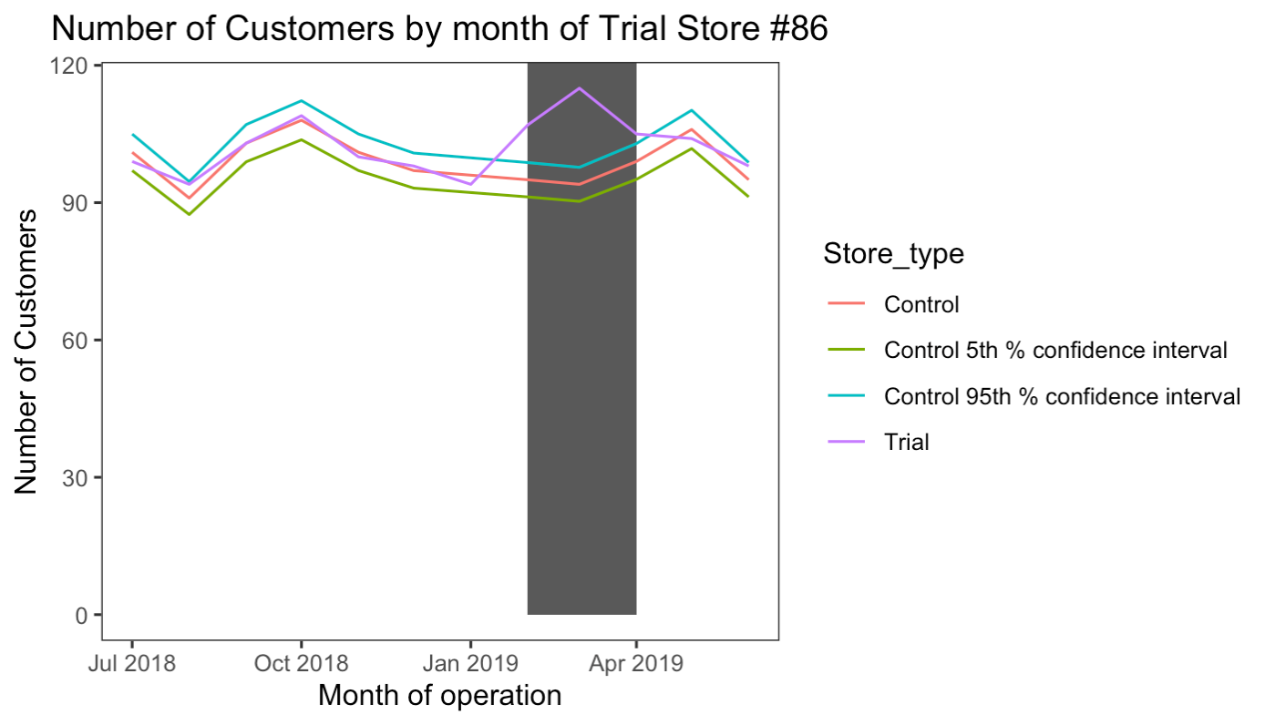
The performance in the trial store #86
The total sales per month were all increase significantly (p<0.05) for Marth, and the number of customers were increase significantly (p<0.05) for all trial period.
SUCCESSFUL!

Slide 12
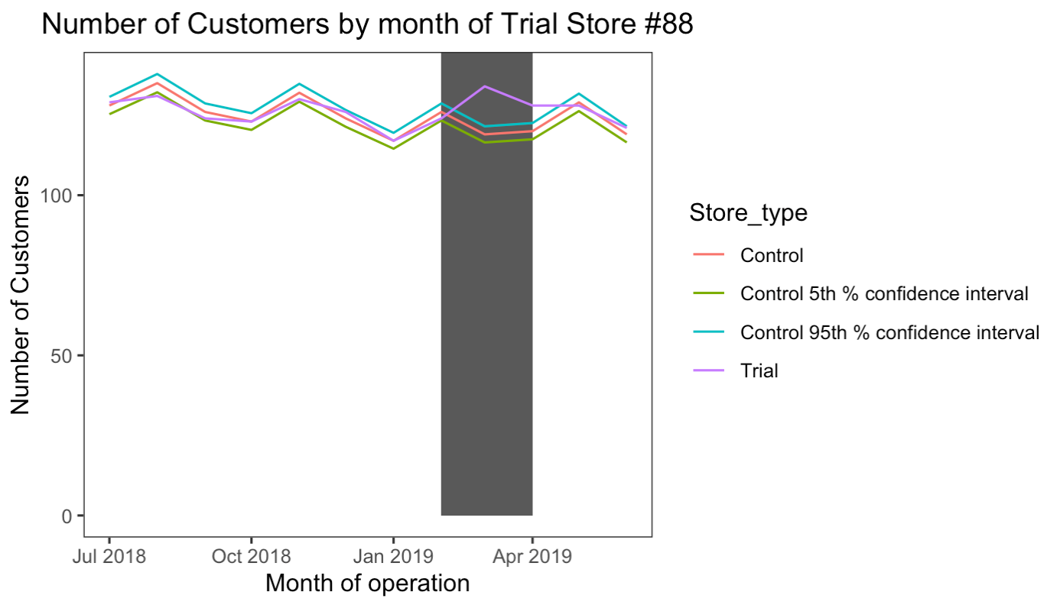
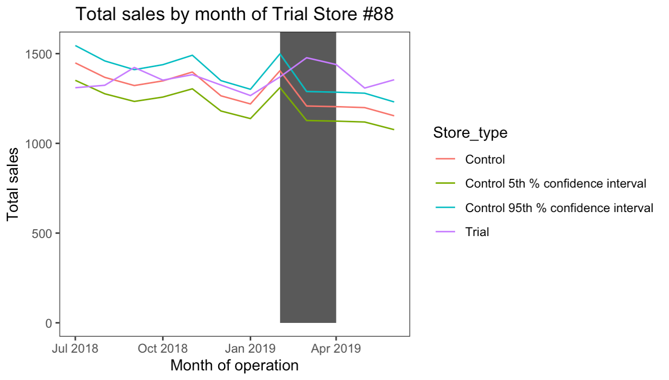
The performance in the trial store #88
The total sales and number of customers per month were increase significantly (p<0.05),
for Marth and April.
SUCCESSFUL!

